Slide 1




ADVANCED IOT AND DATA-DRIVEN SOLUTIONS FOR OPTIMIZING VEHICLE LIFECYCLE MANAGEMENT AND MAINTANANCE
Group ID : 24-25J-172
PP2

Slide 2


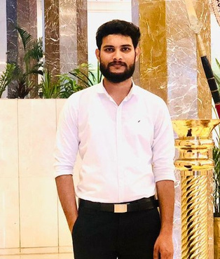



OUR TEAM
Mr.Nelum
Supervisor
Miss.Akshi de silwa
Co- Supervisor
Nafeel SM
Leader
Shukri HM
Member
Ahlaan MI
Member
Nanayakkara G.P.D.P
Member

Slide 3

INTRODUCTION
The automotive industry is evolving with IoT and AI technologies.
Accurate vehicle tracking remains a critical challenge.
Predictive maintenance is needed to reduce downtime.
Personalized vehicle advice can enhance user satisfaction.
Effective parts recommendations require better data analysis.

Slide 4
RESEARCH PROBLEM
How can we accurately track and log the total lifetime travel of vehicles using IoT technology?
How can predictive maintenance be effectively scheduled using real-time sensor data and time series analysis?
How can we provide real-time, personalized vehicle advice through a neural network-based chatbot?
How can customer reviews be leveraged to provide personalized and reliable recommendations for automobile parts?

Slide 5

OBJECTIVES
Enhance vehicle lifecycle management by using IoT and AI technologies to optimize usage, reduce downtime, and provide personalized advice and parts recommendations.

Slide 6
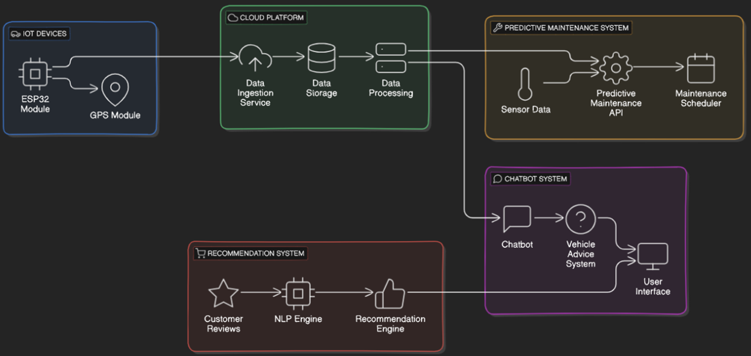
SYSTEM DIAGRAM

Slide 7
COMPONENT
ACCURATELY TRACK AND LOG VEHICLE TRAVEL ON A MAP
Nafeel SM - IT21173554

Slide 8
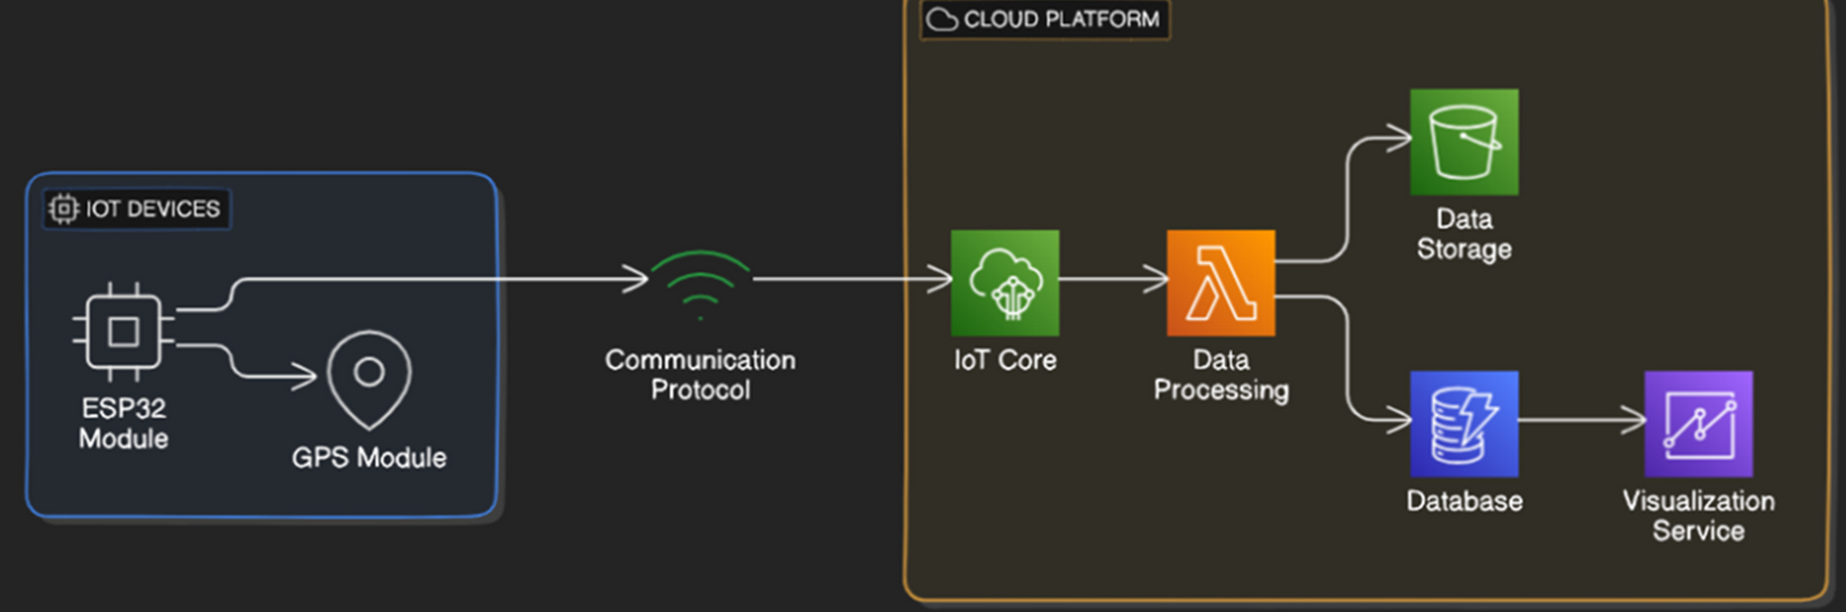
COMPONENT DIAGRAM
Nafeel SM - IT21173554

Slide 9
OBJECTIVE
The primary objective of this function is to develop a comprehensive and cost-effective vehicle tracking system utilizing ESP32 module for real-time GPS monitoring.
Aims to detect total lifetime travel history of the vehicle
Analys future trevel movment of a vehicle based on previous data.

Slide 10
TECHNOLOGIES
General Environment
Python
Google API
FireBase
MAP
ARIMA
Tools
GPS
ESP32 Module

Slide 11
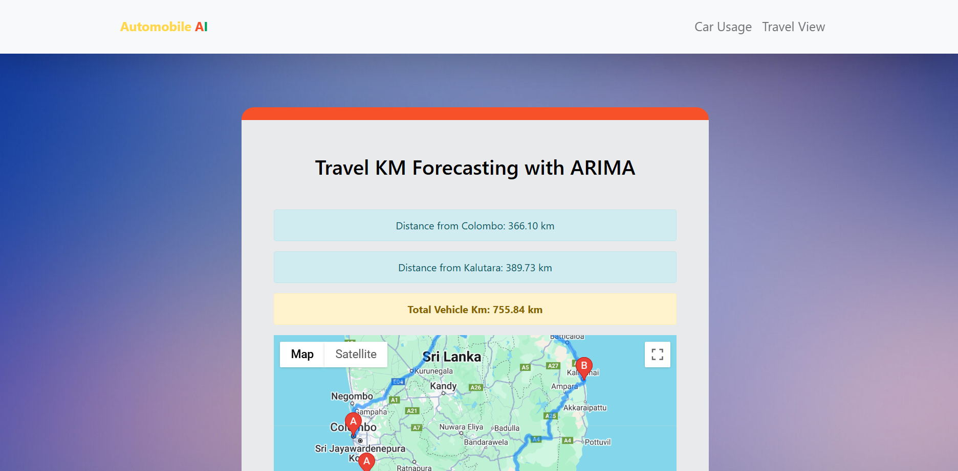
COMPLETION

Slide 12
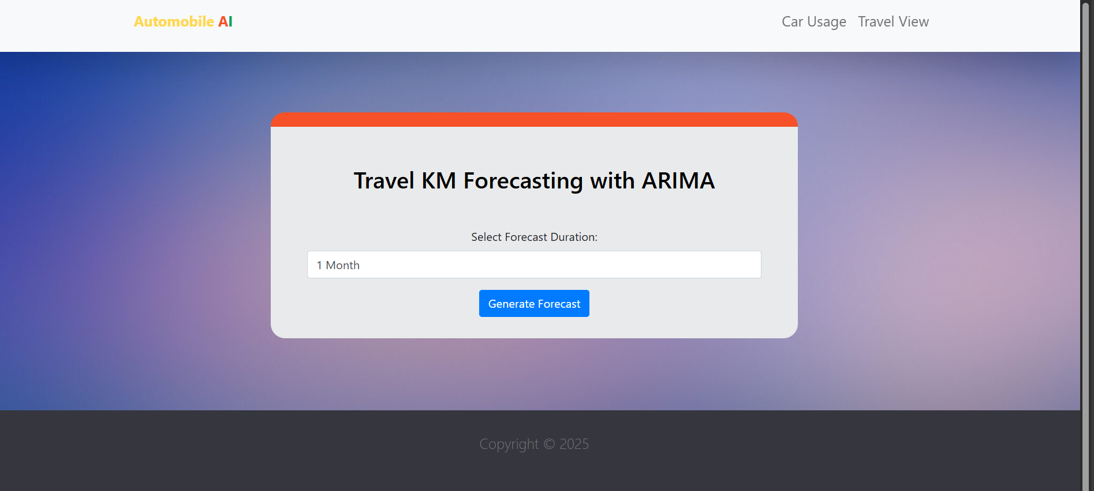
COMPLETION

Slide 13
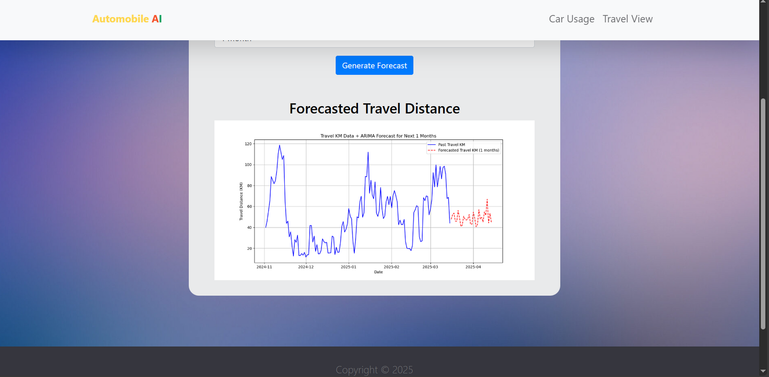
COMPLETION

Slide 14
COMPONENT DEMO
HTTPS://DRIVE.GOOGLE.COM/FILE/D/1NUEXOYTCKF7DRBRAFXDXTXVKPMB4HLEH/VIEW?USP=SHARING

Slide 15
COMPONENT DEMO 2
HTTPS://DRIVE.GOOGLE.COM/FILE/D/1NUEXOYTCKF7DRBRAFXDXTXVKPMB4HLEH/VIEW?USP=SHARING

Slide 16
COMPONENT
DIAGNOSTICS SCHEDULE PREDICTIVE MAINTENANCE
SHUKRI HM - IT21263026

Slide 17
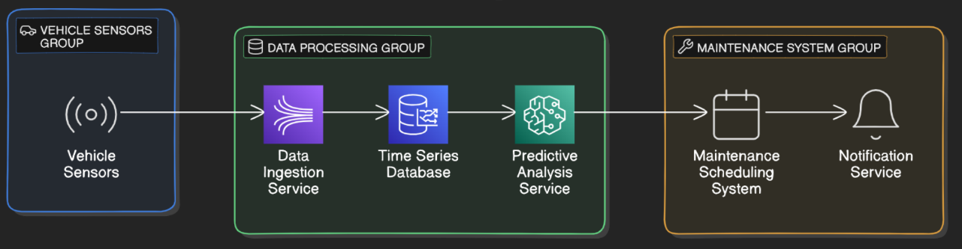
COMPONENT DIAGRAM
Shukri HM - IT21263026

Slide 18
RESEARCH PROBLEM
How can predictive maintenance be effectively scheduled using real-time sensor data and time series analysis
SHUKRI HM - IT21263026

Slide 19
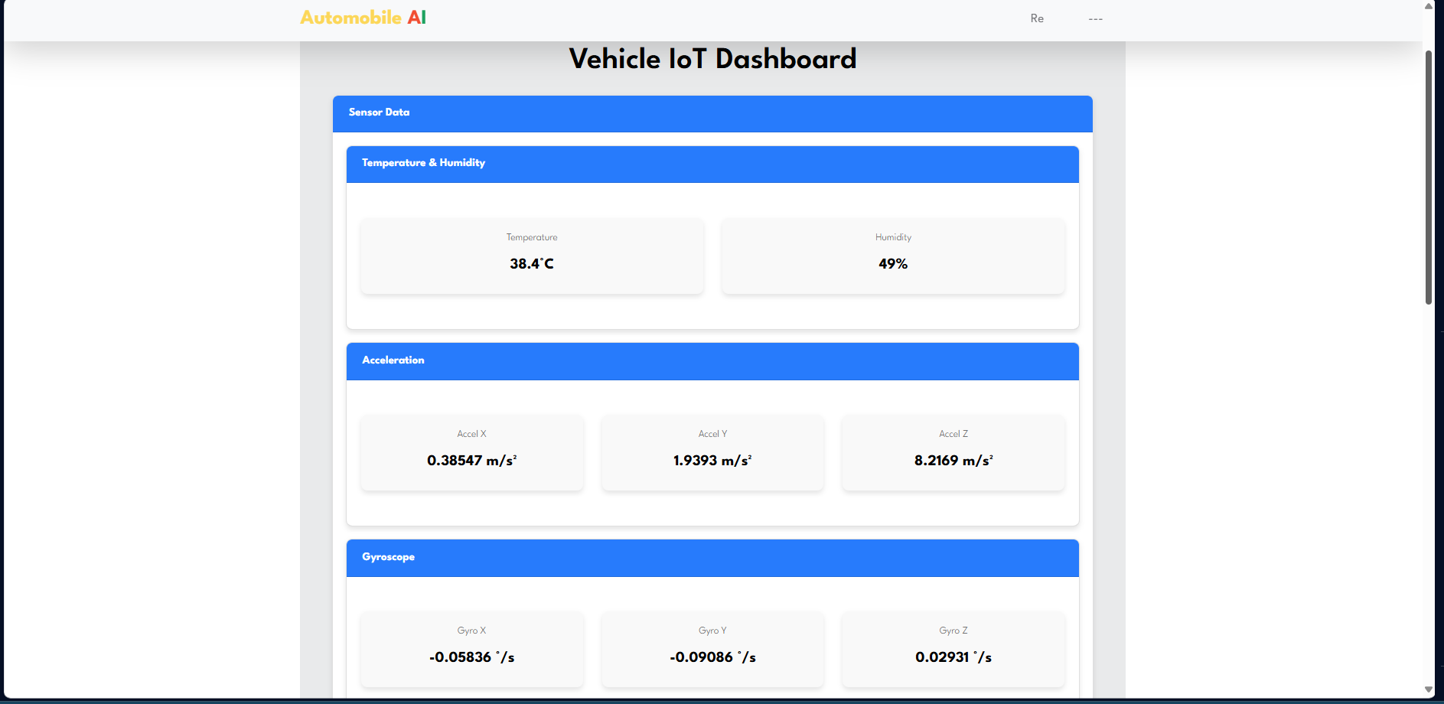
COMPLETION

Slide 20
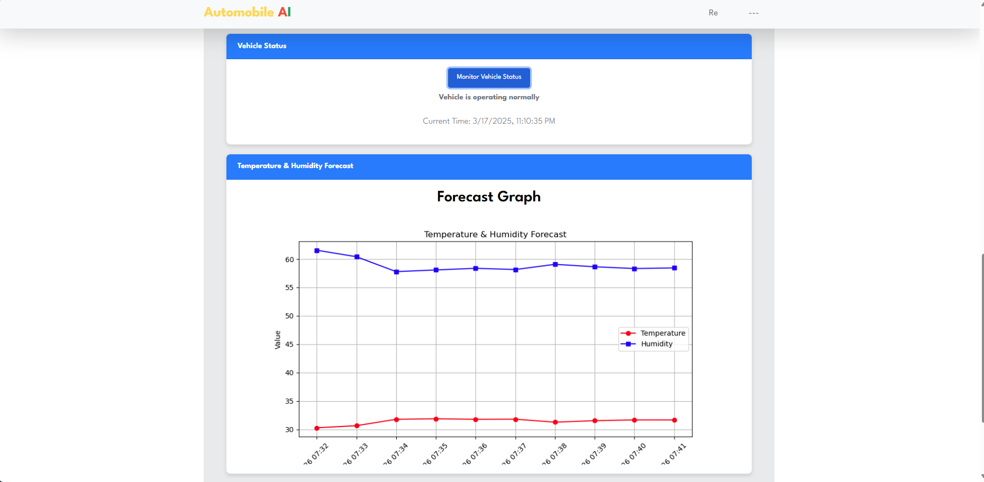
COMPLETION

Slide 21
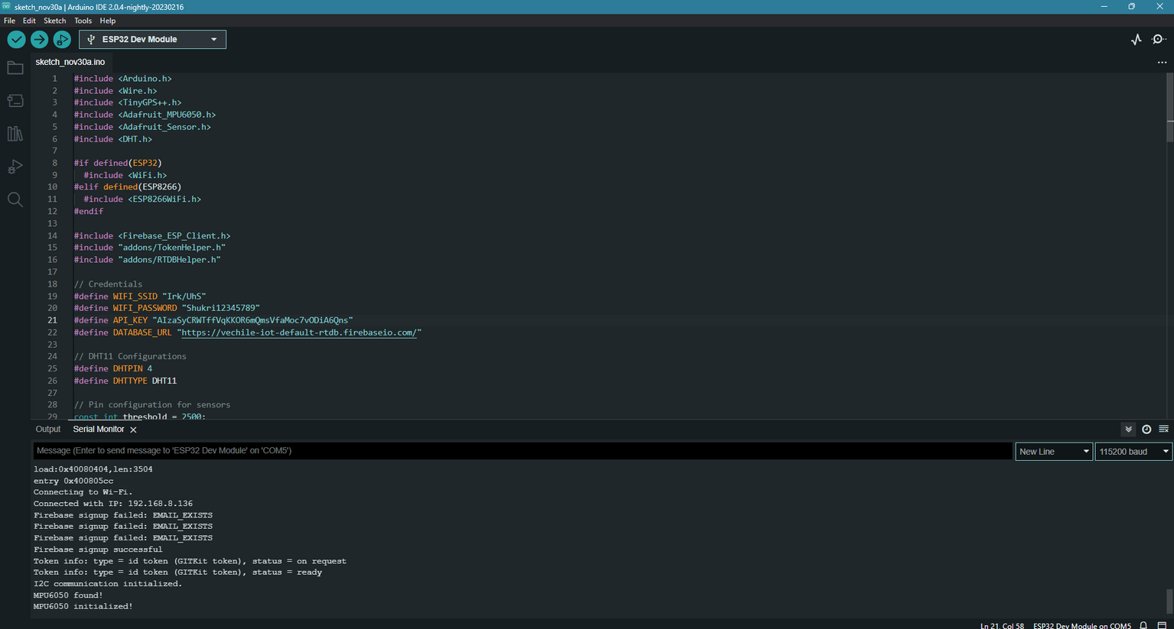
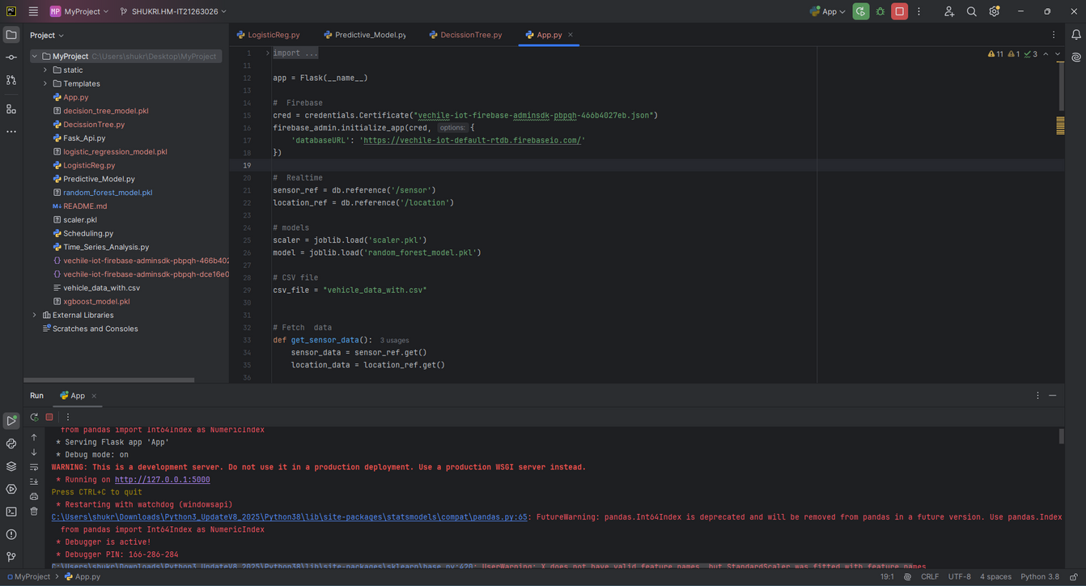
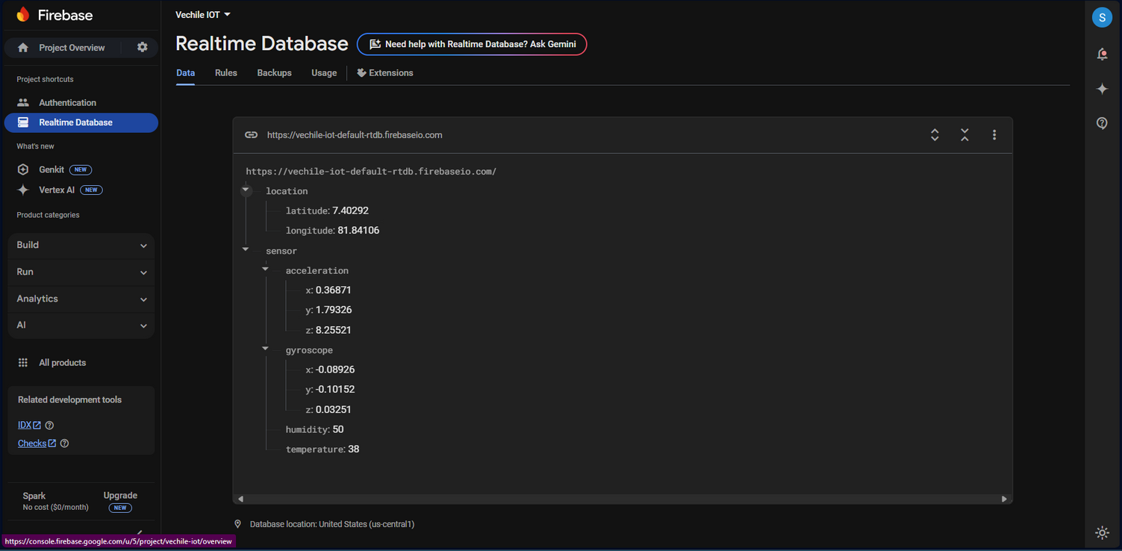
COMPLETION
SHUKRI HM - IT21263026

Slide 22
TECHNOLOGIES
General Environment
Python
Firebase API
FireBase
Arduino IDE
Pycharm IDE
Tools
ESP32 Module
Sensors(MPU 6050,DH 11)
SHUKRI HM - IT21263026

Slide 23
COMPONENT
NEURAL NETWORK-BASED CHATBOT FOR PERSONALIZED VEHICLE ADVICE
Ahlaan MI - IT21296550

Slide 24
RESEARCH PROBLEM
How can we provide real-time, personalized vehicle advice through a neural network-based chatbot?​

Slide 25
OBJECTIVE
Design and train a neural network-based chatbot using extensive vehicle-related data and scenarios.
Integrate the chatbot with a vehicle advice system to offer seamless advice delivery.
Develop a user-friendly interface for easy interaction with the chatbot.
Test and optimize the chatbot to ensure accuracy and user satisfaction.

Slide 26
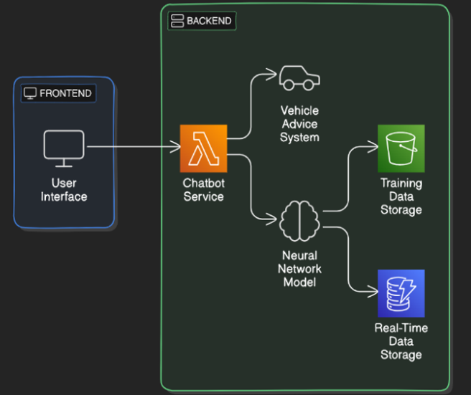
SYSTEM ARCHITECTURE

Slide 27
TECHNOLOGIES
General Environment
Machine Learning
Python
TensorFlow/Keras (Neural Network)
Natural Language Toolkit (NLTK)
Flask (Web API)
JSON (Dataset Storage)
Neural Networks
NLP (Natural Language Processing)
WordNet Lemmatizer
Bag of Words Model

Slide 28
DATASET COLLECTION
Collected data from experienced vehicle mechanics through in-person interviews.
Built a real-world dataset for accurate automobile troubleshooting and recommendations.

Slide 29

FUTURE CHECKLIST FROM PP1
Enhance and refine the dataset for improved performance.
Develop a user-friendly and intuitive UI.
Implement voice integration for the chatbot to ensure safe usage while driving.

Slide 30
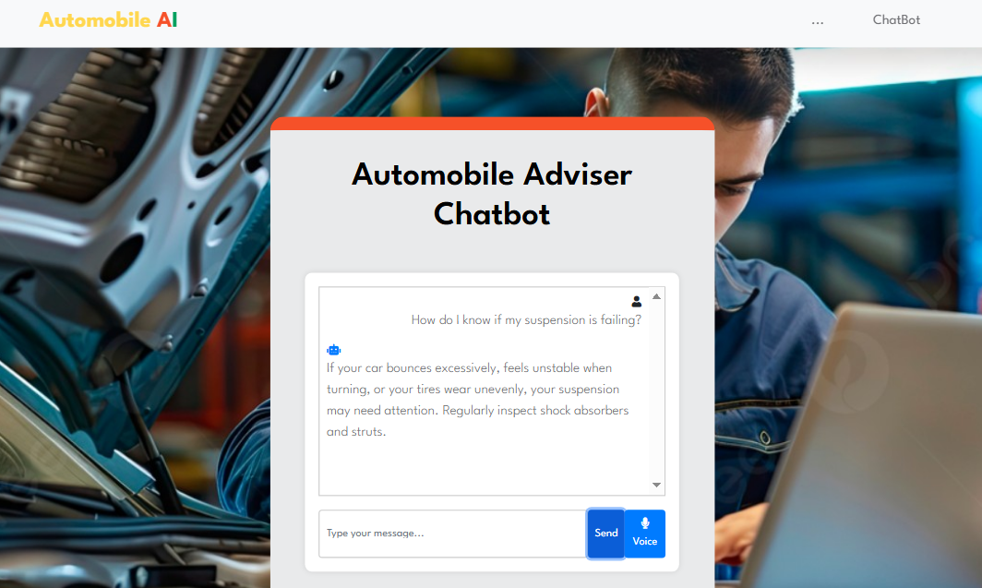
COMPLETION

Slide 31
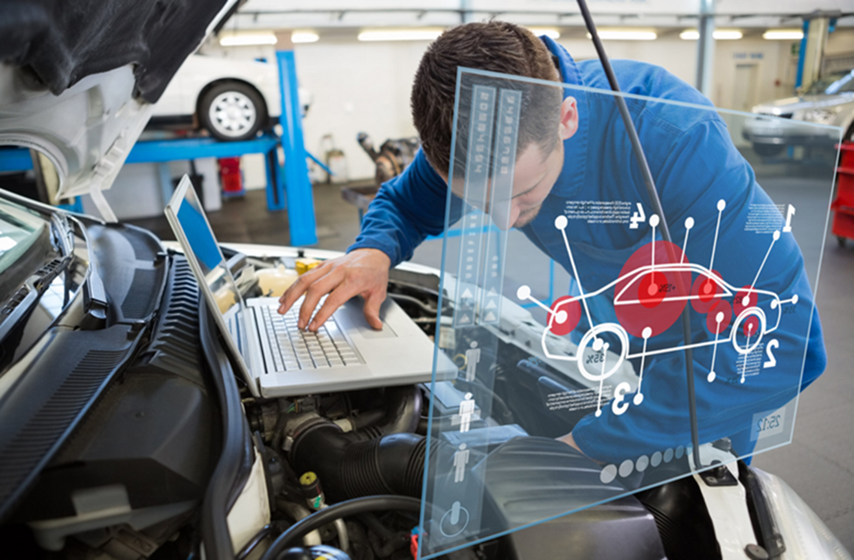
Provide personalized automobile part recommendation G.P.D.P.Nanayakkara (IT21159862 )
•In the rapidly evolving automobile industry, providing personalized recommendations for automobile parts is crucial for enhancing customer satisfaction
Aspects
1.Data Collection
Introduction
2.NLP Implementation
3.Sentiment Analysis.
4.Recommendation System Development
5.System Testing

Slide 32
RESEARCH PROBLEM
How can we develop a system that accurately recommends automobile parts based on individual preferences and experiences as captured through customer reviews and feedback?
NANAYAKKARA G.P.D.P. - IT21159862

Slide 33
OBJECTIVE
Apply Natural Languange processing ( NLP ) techniques to process and analyze the gathered customerreviews.
Utilize TexBlob , Python library, for performing sentiment analysis on the customer feedback to determine the sentiment poarity
Develop a Recommendation Engine
Test and refine the system

Slide 34
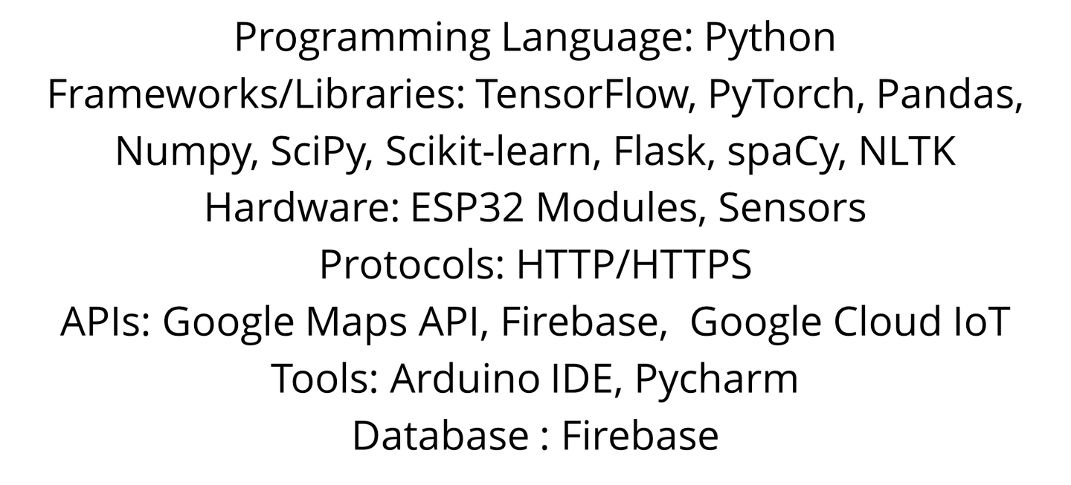
TECHNOLOGIES

Slide 35
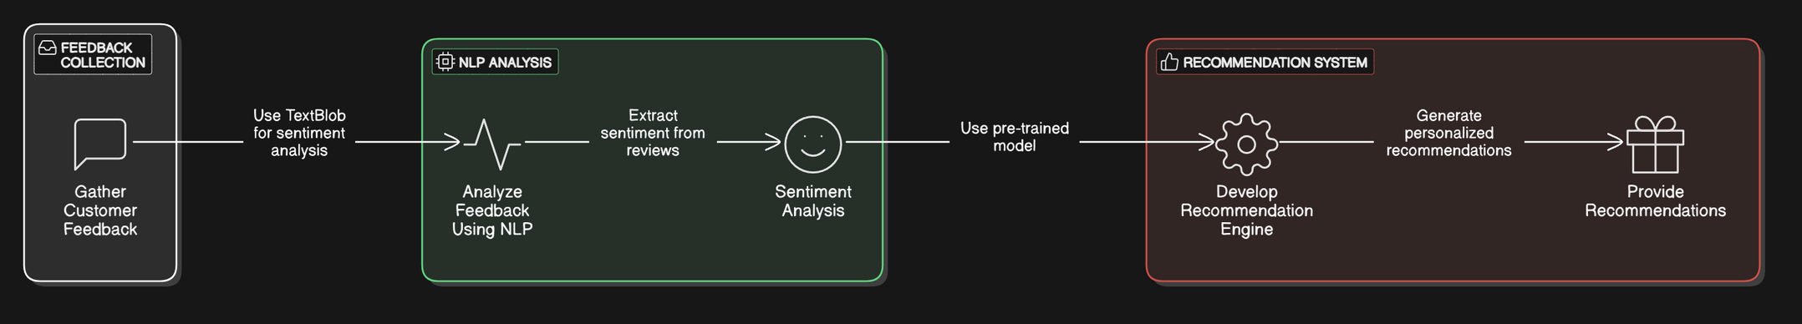
COMPONENT DIAGRAM
Nanayakkara G.P.D.P - IT21159862

Slide 36
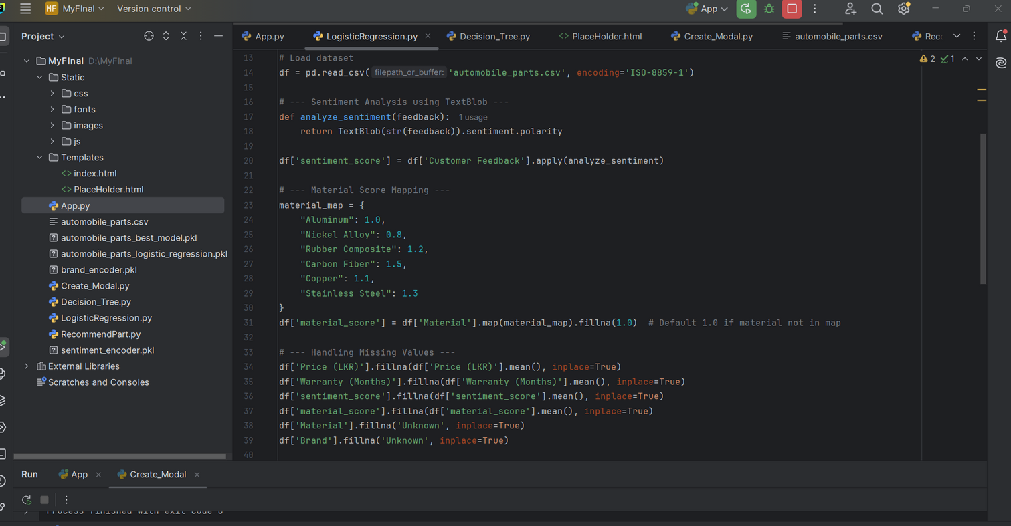
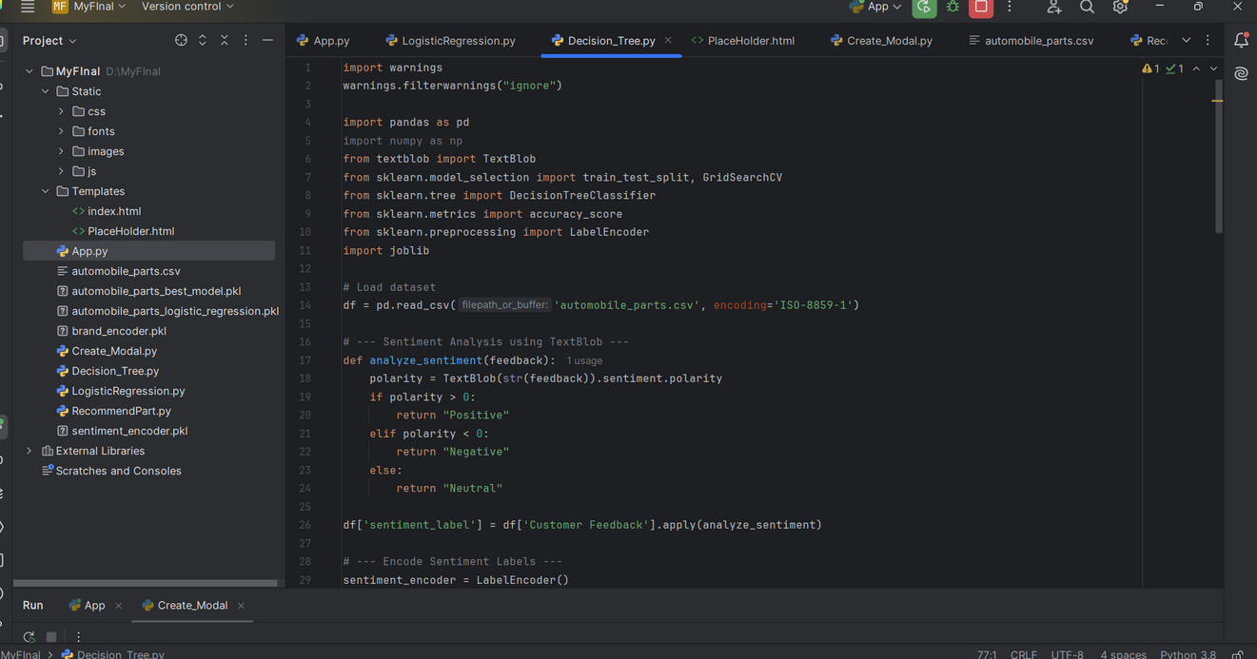
COMPLETION

Slide 37
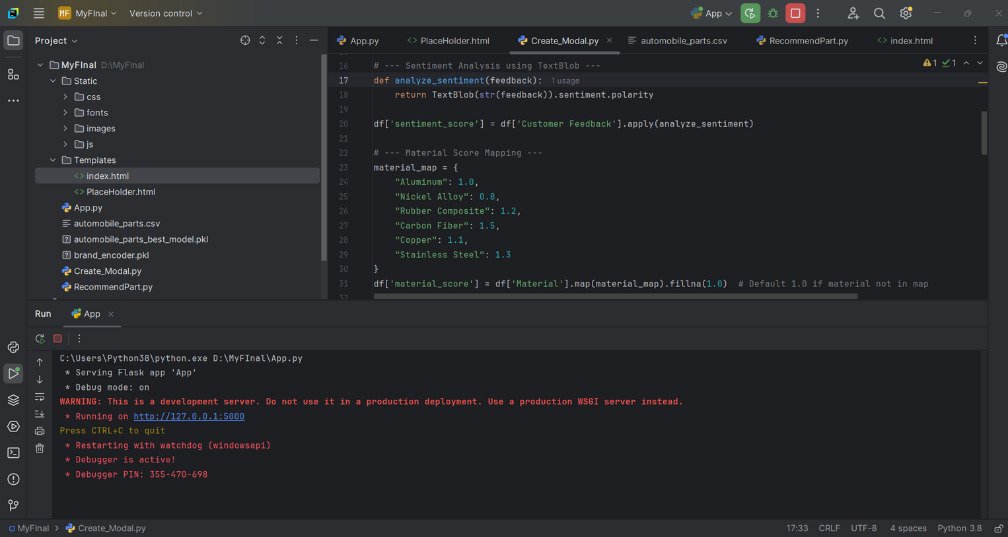
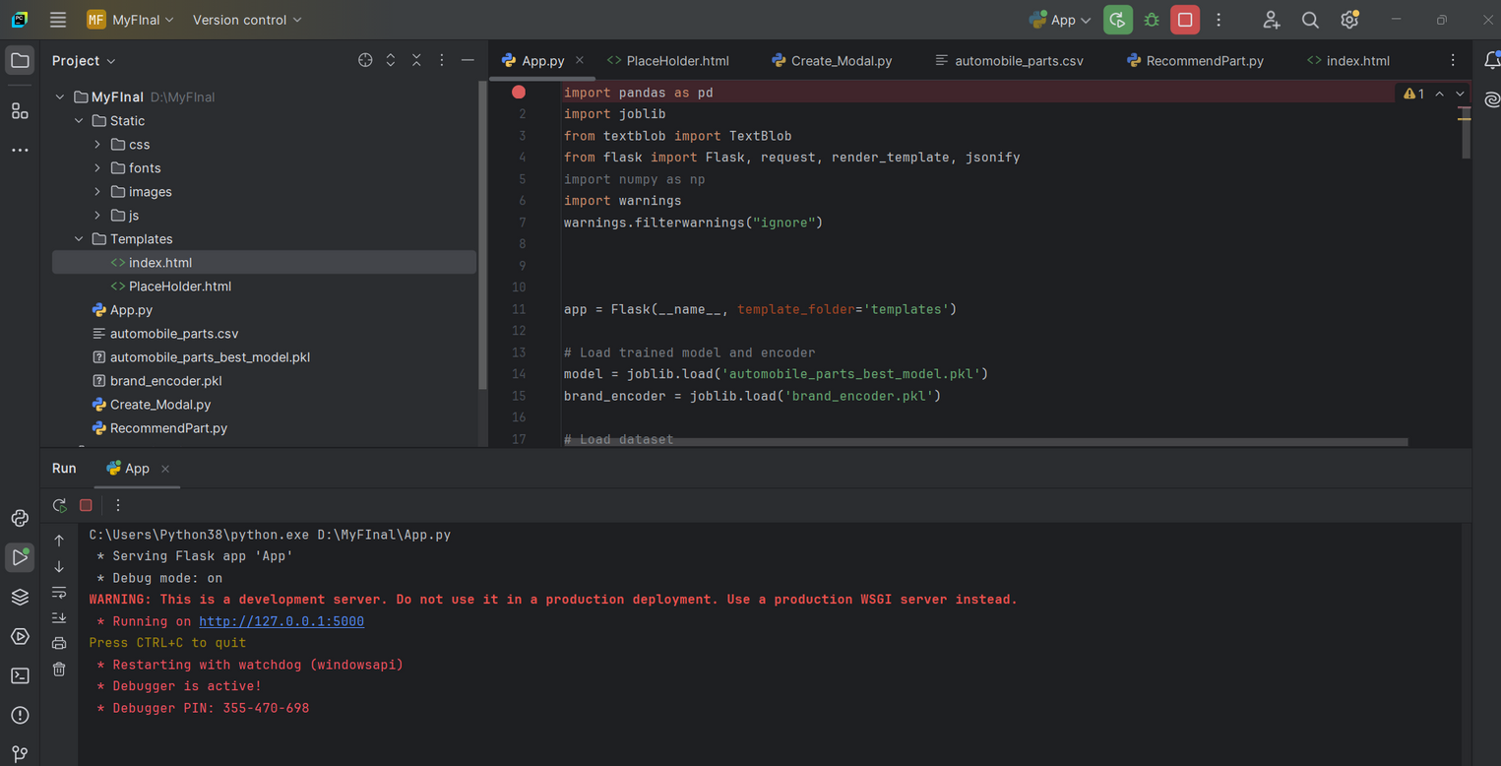
COMPLETION

Slide 38
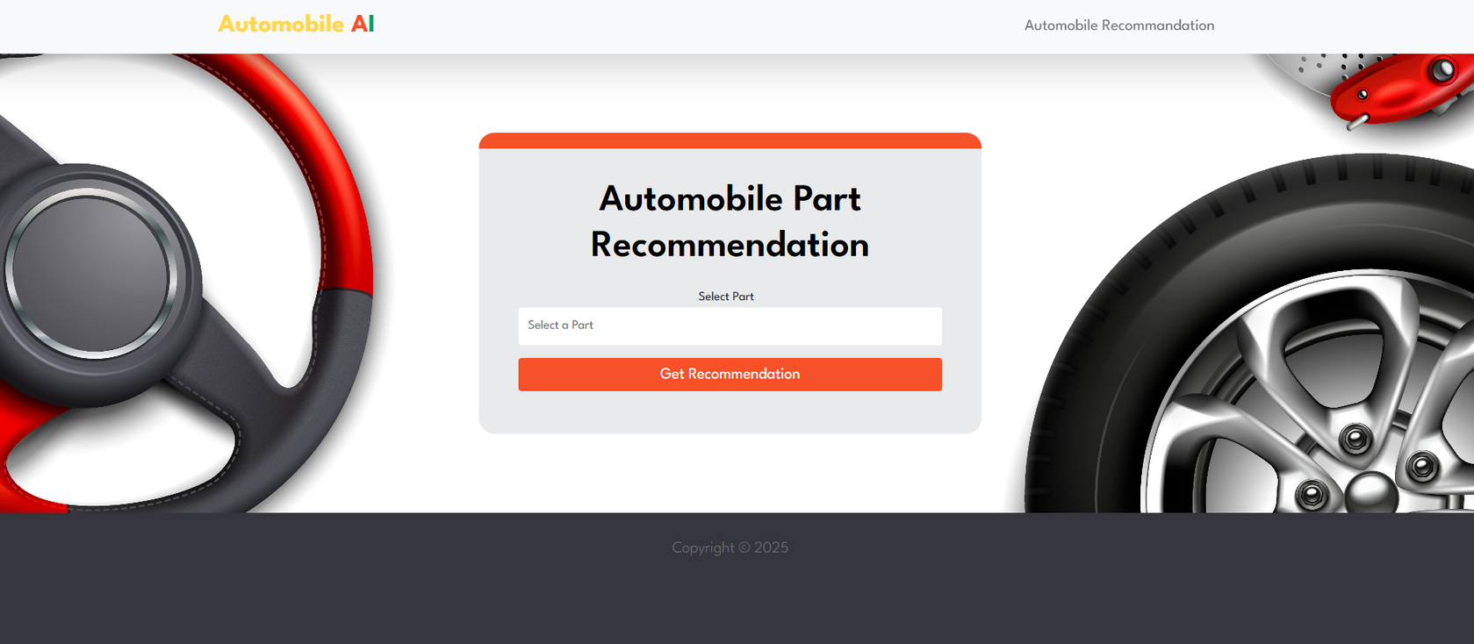
COMPLETION

Slide 39
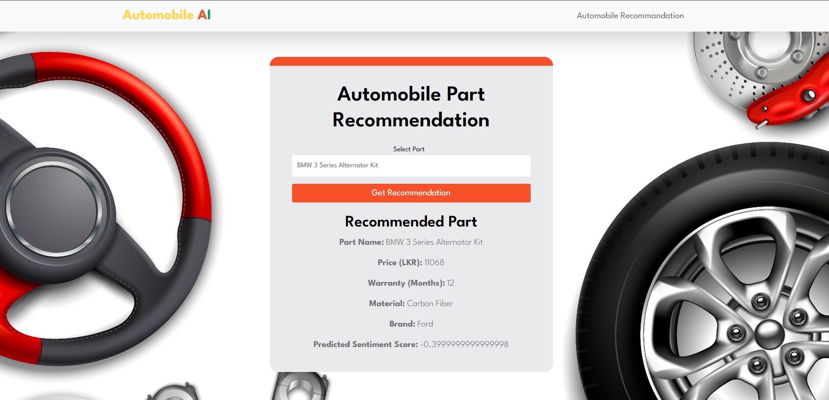
COMPLETION

Slide 40
DEMO
https://drive.google.com/file/d/1aCcSczSToH7djJXxAECbKNBXOvFyudY6/view?usp=drive_link
NANAYAKKARA G.P.D.P. - IT21159862

Slide 41
DEMO
https://drive.google.com/file/d/1nGuUKVrMyA1gOsXER2V-x072IrhsZA6Y/view?usp=drive_link
NANAYAKKARA G.P.D.P. - IT21159862

Slide 42
DEMO
..https://drive.google.com/drive/u/0/folders/1FYFdbCZeSppIyHAsXdYNgULRWwOI3K0a?q=sharedwith:public%20parent:1FYFdbCZeSppIyHAsXdYNgULRWwOI3K0a

Slide 43
REFERENCES
[1] S. W. L. R. H. and D. V. B. P. A., "A machine learning-based predictive maintenance framework for the automotive industry," IEEE Transactions on Industrial Informatics, vol. 16, no. 5, pp. 2994-3006, May 2020.
[2] P. R. S. K. G. and V. P. M., "Real-time vehicle tracking system based on GPS and IoT," IEEE Access, vol. 8, pp. 12345-12358, Apr. 2021.
[3] T. R. F. and M. M. S., "Vehicle health monitoring system using IoT-based sensor network," IEEE Sensors Journal, vol. 19, no. 7, pp. 2503-2512, Apr. 2020.
[4] P. R. K. G., "Data-driven predictive maintenance for the automotive industry," IEEE Transactions on Automation Science and Engineering, vol. 17, no. 6, pp. 4155-4165, Dec. 2020.
[5] K. A. D. A. and T. L. W., "AI-powered vehicle maintenance system using sensor data analysis," IEEE Intelligent Systems, vol. 32, no. 3, pp. 75-85, May/Jun. 2020.
[6] M. H. D. and J. R. C., "Improving predictive maintenance models for automotive sensors using machine learning algorithms," IEEE Transactions on Industrial Electronics, vol. 67, no. 12, pp. 9901-9910, Dec. 2020.

